Slide 1



Automated Financial Commentary Generation
Business Analytics Centre Symposium (BACS) 2020
26 September 2020 | Singapore
Presented by: Utkarsh Chaturvedi
Supervised by: Prof. Teo Thompson
Notes:
.

Slide 2
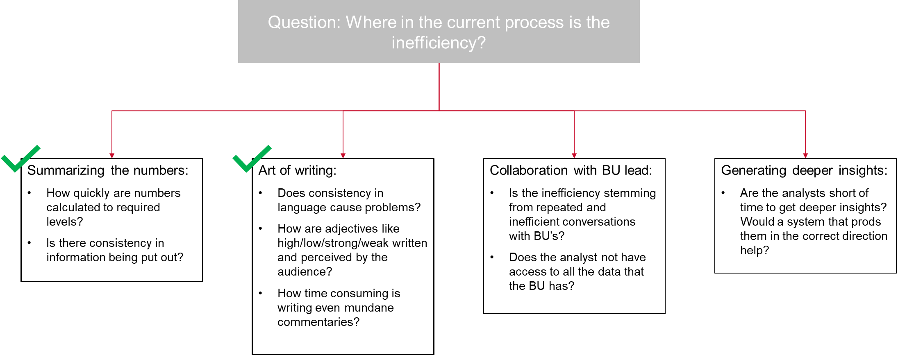
What was the business problem?
To help financial analysts increase their efficiency by automating the task of writing lower level commentaries and re-directing their efforts on identifying causality of important financial numbers
Notes:
It is critical to understand the business context around this project. The business wanted a solution to the inefficiency of writing financial commentaries, which are manually written every month by analysts for range of products incoprporating their sales, costs and other business parameters. On detailed discussions with them, it was identified that a system that is able to quickly manipulate numbers and present them in a commentary fashion similar to what the business is used to seeing would be the best approach.
Once this was established, the project itself was executed in 4 key steps

Slide 3
What was the solution approach?
The process was broken down to 4 separate components:
Analysis of the language
Building codes to ensure flexibility of usage across product hierarchies, geographies and BU’s
Using NLG tools to realise the language
A front-end to facilitate ease-of-use of product

Slide 4
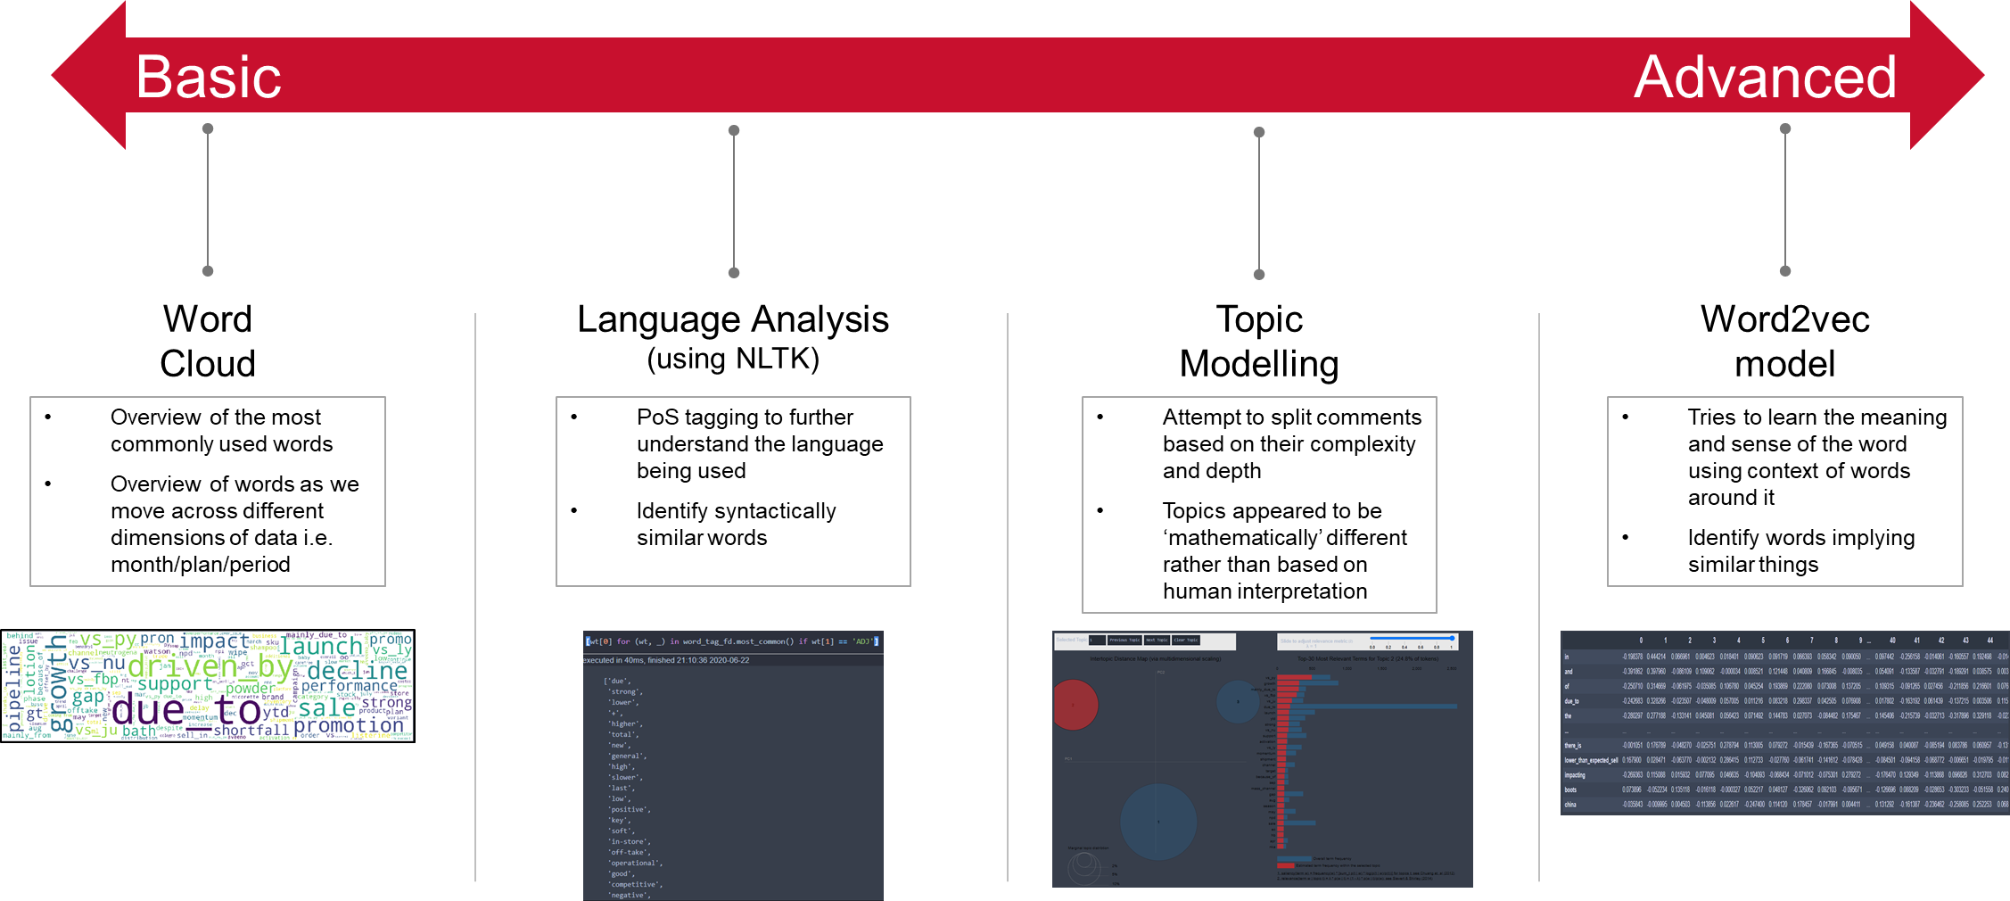
Deep-dive into the tool
Step 1: Analysis of language
Notes:
How individual tokens are treated? Individual independent of all context around it vs Word2vec model understands context. Example: ‘Higher’ vs. ‘Lower’?

Slide 5
Deep-dive into the tool
Step 2: A technical coding challenge
The solution was built with a key requirement of being flexible and robust to variations in data input structure, product and geographical hierarchies across business-units and ease-of-use to analysts
As a result, there could be no-hardcoded columns or values within the entire code
Notes:
The system needed to be deployable across a range geo, products and Businees Units. This meant no hard-coding of file names, column-names or even data structure.

Slide 6
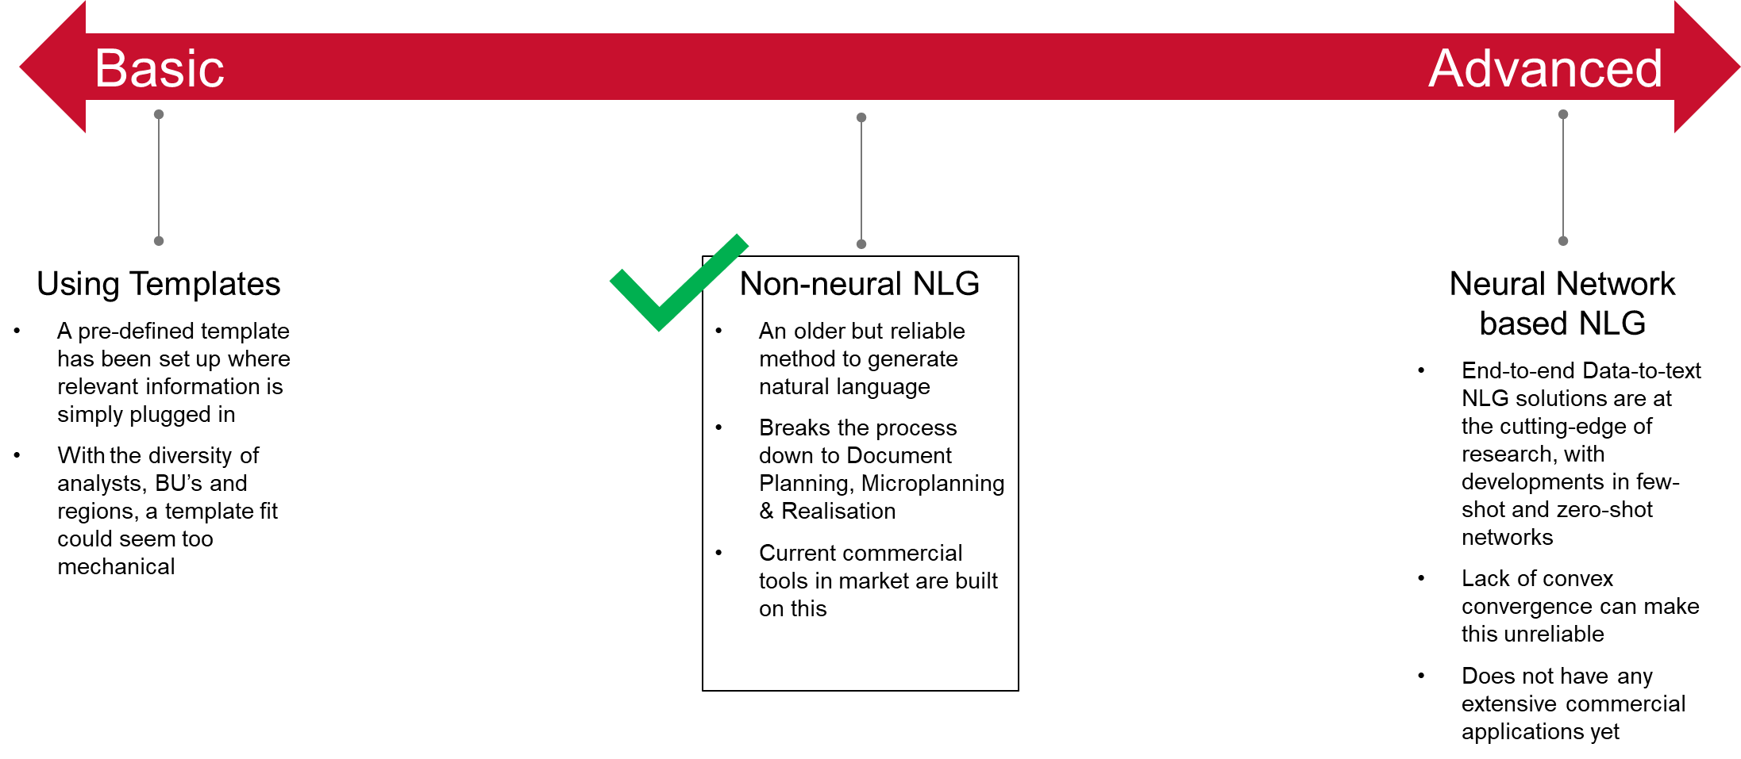
Deep-dive into the tool
Step 3(i): Generating the language
Notes:
Data hallucination

Slide 7
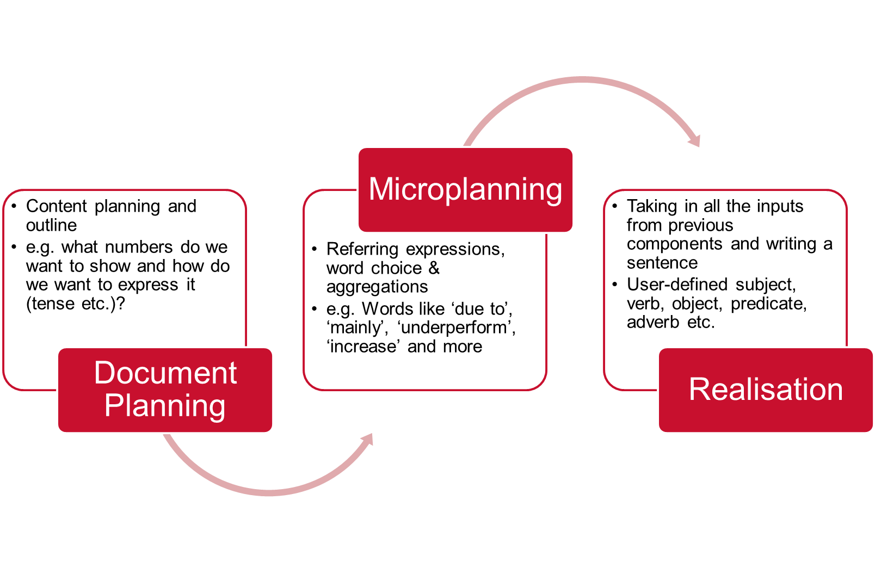
Deep-dive into the tool
Step 3(ii): Non-neural NLG - how does it work?

Slide 8
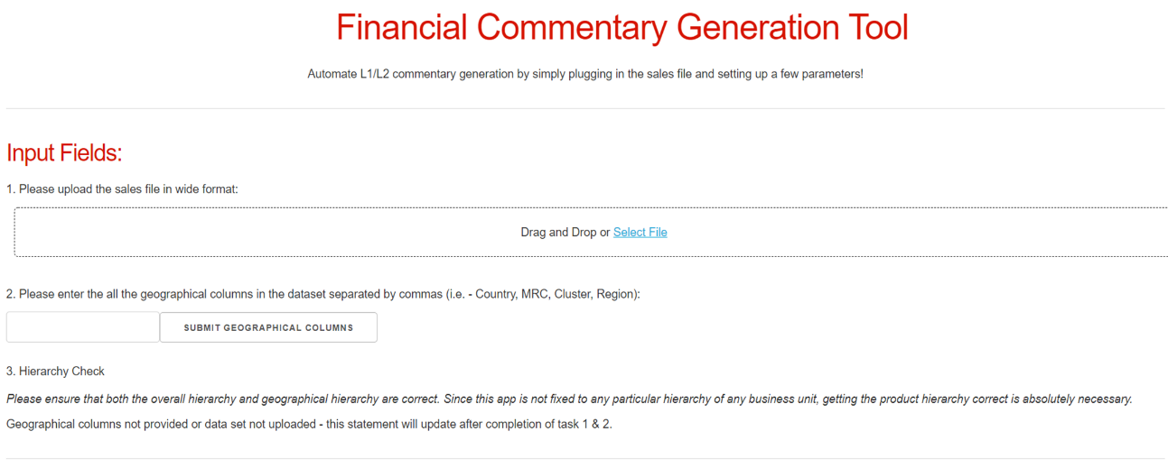
Deep-dive into the tool
Step 4: Dash-plotly based web-tool
Notes:
No project is complete without a tool that enables deployment and evangilisation across the org, and that is why Dash-plotly is used to develop a web-based tool

Slide 9
Deep-dive into the tool
Features of the tool:
Flexibility to user
No hard-coded features or columns - user can use any columns name/hierarchies provided, some bare necessary columns such as NTS/Period/Month are present
Easy to modify front-end for different needs across BU’s/geographies
Modular function-based backend allowing for easy modifications in further iterations
The current codes have been written to ensure that further feature addition takes minimal effort

Slide 10
What next?
Showcase current capabilities and try to incorporate feedback from the end-user(s)
Set up meetings with multiple stakeholders to raise awareness and get their buy-in
Diversify data sources and work towards generating advanced level commentaries
Need to have further discussions with the analyst on the sources of information and how it is processed to arrive at the comment

Slide 11







THANK YOU!
Utkarsh Chaturvedi
+65-84117760
utkarsh.chaturvedi@u.nus.edu
utkarshchaturvedi95

